Slide 1



Predicting a location to start a Coffee Shop in Toronto
Sajith Bhaskaran
Aug 2020

Slide 2
Research Scenario
The main premise of our research will center on investigating and determining the ideal locale in Toronto, Canada, for the establishment of a new coffee/take away shop, a shop targeting people whose are on the go. In this study, I endeavor to identify the right location by finding the right cluster of people and amenities, and lack of quick eats. We must investigate the issue in a scientific method using Data Science as there is an opportunity for wasting money and effort by investing at a non-optimal location. Data Science provides best possible location based on available data.

Slide 3
Research Scenario
We will need data about different venues in different neighborhoods of that specific borough. In order to gain that information we will use "Foursquare" locational information.
We will use Wikipedia to get Postal Codes of the Toronto Suburbs.
We will export them to CSV files and combine to create maps and analysis reports.

Slide 4
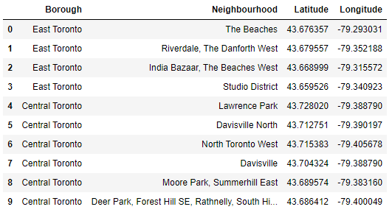
Problem Focus
Identifying the Best Location for a New Business, using location data, via Postal Codes [Neighborhoods in Toronto]

Slide 5
Problem Focus
Connecting to Foursquare and Retrieving Locational Data for Each Venue in Every Neighborhood
After finding the list of neighborhoods, we then connect to the Foursquare API to gather information about venues inside each and every neighborhood. For each neighborhood, we have chosen the radius to be 1000 meter. It means that we have asked Foursquare to find venues that are at most 1000 meter far from the center of the neighborhood.

Slide 6
Decision Making
This report may be helpful for someone planning on opening a restaurant in Toronto, as any similar such type of business.
They can be confident that by comparing the current offers and neighborhoods profiles, however it may not cover all variables such as access to public transportation or even the restaurants profiles, so it shall not be used as a single decision-making tool.
Reports of this nature have a shelf life and one should always appreciate and contextualize their process going forward.

Slide 7
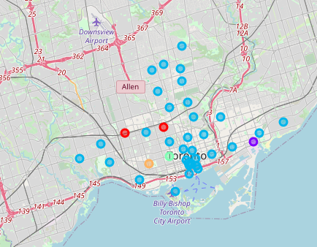
Decision Making and Reporting Results
The illustration below shows the final neighborhood cluster, East Toronto postal business processing , in purple as the best location.

Slide 8
Conclusion
After examining the above clusters, I believe and would recommend that cluster label (1), East Toronto, business mail processing center is the best Neighborhood to set up shop for a new business venture. While there are great locations like downtown this presents the best opportunity to be a first mover as well an early entrant into a community that is poised to experience phenomenal growth. East Toronto is the most suitable locale as it has an expanding population, colleges, a dependable public transport system, supporting entities for the productive population a business will need and attract.

